Slide 1
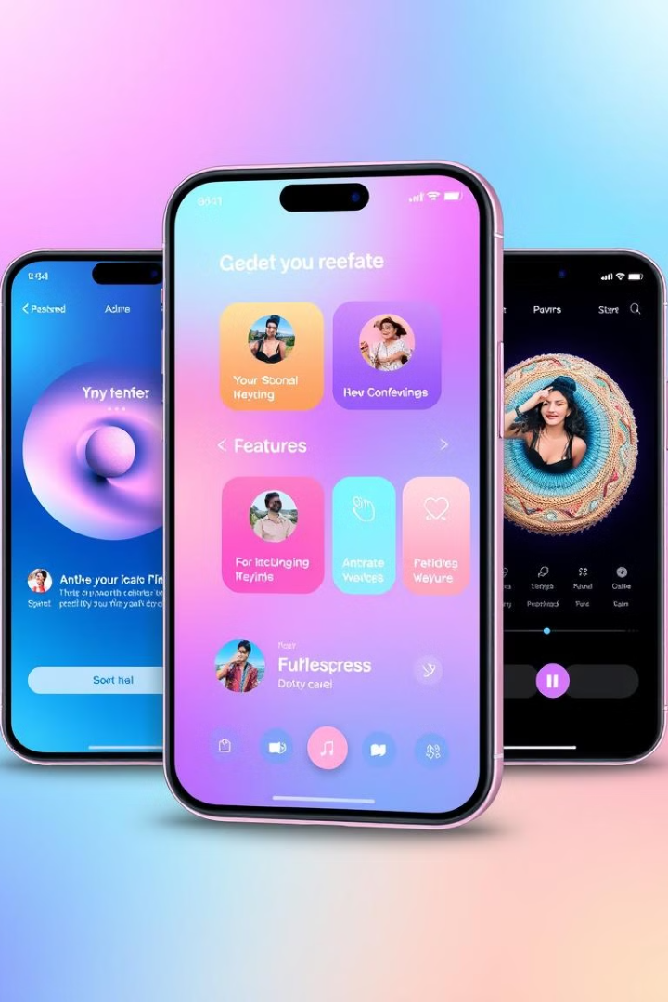
Mobile App Development: A Comprehensive Guide
This presentation provides a comprehensive overview of mobile app development, covering app types, programming languages, development costs, and cost-saving strategies. It aims to equip businesses with the knowledge to make informed decisions and effectively plan their app development projects.
GR
By Group 19

Slide 2
Types of Mobile Apps: Native, PWA, and Hybrid
Native Apps
Progressive Web Apps (PWAs)
Hybrid Apps
Built for a specific mobile OS (iOS or Android), offering optimal performance and access to device features. Examples include WhatsApp, Apple Music, and Spotify. Native apps are faster and more reliable but require separate development efforts for each platform, increasing costs and maintenance.
Blend web and native app features, installable from a browser without an app store. PWAs work offline, support push notifications, and are lightweight. Examples include Pinterest and Uber. PWAs offer easier maintenance but have limited access to device-specific features.
Combine web technologies (HTML5, CSS, JavaScript) within a native shell, enabling cross-platform compatibility. Frameworks like React Native and Flutter are used. Examples include Instagram and Facebook. Hybrid apps are quicker and more economical but may lack the power and speed of native apps.

Slide 3



Choosing the Right App Type
Need an App ASAP?
Limited Resources?
Invest in a web app or PWA for the fastest development time, leveraging a single codebase and browser accessibility.
Consider a PWA or hybrid app to test the market with a minimum viable product within a few months.
Performance is Key?
Develop a native app for the best speed, stability, and customization features.

Slide 4



Mobile App Programming Languages
Java
Well-suited for complex tasks with extensive resources, but can be inefficient for quick tasks.
Swift
Easy to read and simplifies error catching for iOS development, but has compatibility issues with other OS.
Kotlin
Interoperable with Java, providing native-level support on multiple platforms, but has limited resources.

Slide 5

Mobile App Development Frameworks
Framework
Best Known For
Performance
React Native
Building native-like apps with code that works on both iOS and Android
Good, uses native components but slower than Flutter
Flutter
Creating beautiful, high-performance apps with customizable designs
Excellent, compiles to native code for high speed
Ionic
Quickly developing simple apps using familiar web technologies
Moderate, performance limited by WebView rendering

Slide 6
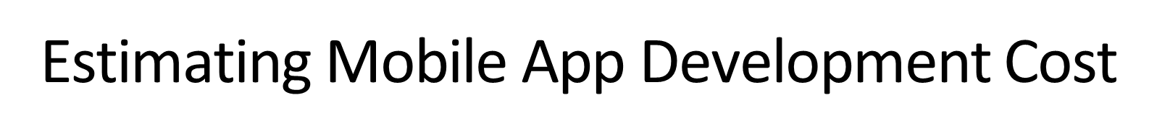
$10K-$50K
$50K-$100K
Simple Apps
Medium Apps
Unit converters, to-do lists
Fitness trackers, restaurant booking
$100K+
Complex Apps
E-commerce, social media

Slide 7



Cost-Saving Strategies for Mobile App Development
Define Clear Requirements
Avoid scope creep by ensuring the project scope is well-defined.
Cross-Platform Development
Use tools like Flutter or React Native for simultaneous iOS and Android development.
MVP Launch
Test the app with fewer features and iterate based on user feedback.

Slide 8






Key Takeaways and Next Steps
Plan Budget Carefully
Factor in complexity and maintenance costs.
Choose App Type Wisely
Consider native, PWA, or hybrid based on needs.
Implement Cost-Saving Strategies
Define requirements, use cross-platform tools, and launch an MVP.

